Slide 2
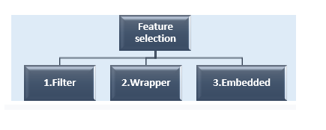
Feature Subselection

Slide 3
Filter-based feature selection:
Filter based approach selects the best feature from the original features set based on some statistical criteria.
The process of selecting the significant features is independent of ML algorithms that will be used in building the model. The outline of the filter approach is as shown below:

Slide 4
Since the filter doesn’t consider the ML model to evaluate the relevance of the features, it is faster, but the performance of the model is not ensured.
Two strategies are used by feature selection techniques:
eliminate the correlated/redundant features
select features which impact the target variable

Slide 5
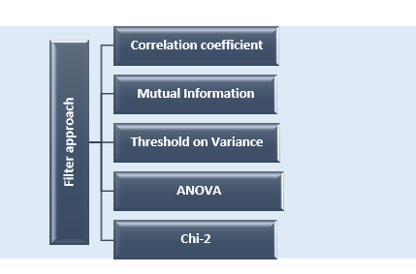
Filter approaches

Slide 6
Wrapper based feature selection:
The filter feature selection approach does not consider the machine learning model performance while selecting the features. Therefore, there is no way for the ML engineer to evaluate the performance of the selected features until he builds the model.
To account for the model performance while selecting the features, the wrapper approach is introduced.

Slide 7
Below given figure depicts the wrapper-based feature selection approach.
Raw data that is represented in original feature space is considered as input. Certain feature selection strategy is applied to select the best subset of features which is then used to train the machine learning model. The performance of the model is evaluated and to check the relevance of the features. The estimated accuracy is feedback to selection strategy and this process is iterated until optimal features are selected which results in maximum accuracy.

Slide 8
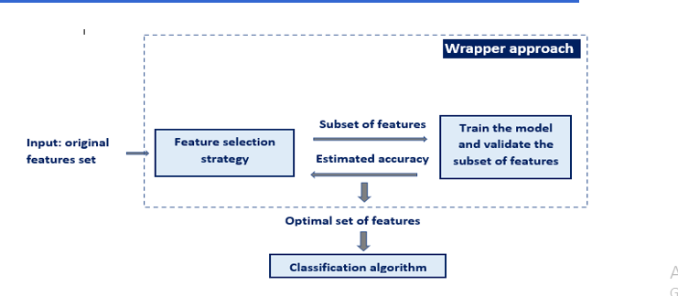

Slide 9
Wrapper approaches can be broadly categorized into three groups:
i. Sequential forward selection,
ii. Sequential backward selection and
iii. Exhaustive feature selection.

Slide 10
i. Sequential Forward Selection:
The steps to forward selection are:
Select the first feature, train the model with the selected feature, and evaluate the model (classifier) performance.
Select a next feature, train the model with the combined features (first and the next) and evaluate the model (classifier) performance.
Repeat step1 and step2 until no significant improvement in model performance is observed by adding next features, or stop when the desired number of features is selected.

Slide 11
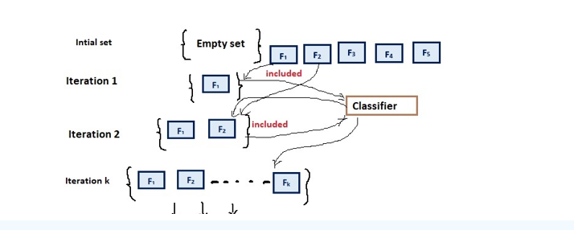

Slide 12
ii. Sequential backward selection:
The steps to backward selection are:
Consider all the features, train the model, and evaluate the performance.
Discard the feature which do not decrease the model performance when removed.
Repeat step1 and step2 until when no significant decrease in the model performance is observed by removing any feature, or the desired number of features is selected.
Both techniques are fast but do not guarantee that another untried feature set is not better. It only guarantees to eliminate features whose information content is subsumed by other features.

Slide 13
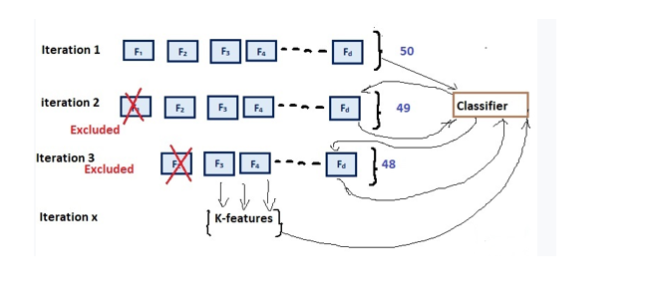

Slide 14
ii. Exhaustive feature selection
Exhaustive Feature Selection (EFS) algorithm is a wrapper-based approach. Its objective is to evaluate all the possible feature combinations and select the best subset of features. An appropriate machine learning technique like classifier or regressor can be used to evaluate the best combination of features. Suppose a data set with four features are given as input to exhaustive feature selection technique with logistic regression as the performance evaluator, then EFS will try all 15 feature combinations.

Slide 15
Embedded Feature Selection:
The approach of integrating the feature selection with ML algorithm is said to be Embedded feature selection.
The embedded approach uses the combined approach of filters and wrappers.
The embedded approach is designed as part of some of the ML algorithms.

Slide 16
Examples:
Random forest classifier is an embedded feature selection as it finds the optimal set of features while training the models.
Regularisation is another embedded approach of choosing the features. It uses L1-norm for LASSO regularization and L2-norm for ridge regularization.

Slide 17
Advantages of Embedded approaches are:
they account for the performance of the learning model while selecting the features like the wrapper approach.
Like the filter approach, embedded methods converge very fast while selecting the features, but the features obtained from the wrapper are more accurate than the filter.
The embedded approach is they are don’t suffer from the over-fitting problem.
Let us see a demonstration of regularization based on embedded feature selection.
Regularisation approach:
The Regularisation approach includes:
i. Lasso (L1 regularisation) and
ii. Ridge (L2 regularisation)

